Slide 1
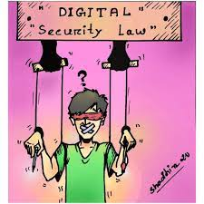

Intellectual Property, ICT ACT and Digital security act

Slide 2

Intellectual Property
What is Intellectual Property?
The intangible creative work, not its particular physical form
Value of intelligence and artistic work comes from creativity, ideas, research, skills, labor, non-material efforts and attributes the creator provides
Protected by copyrights, patent laws or trademarks.

Slide 3
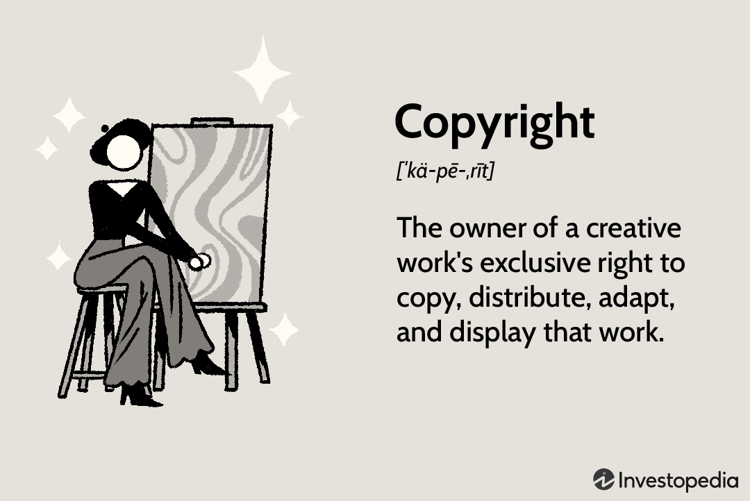
Copyright
What is “copy right”? ©
Copyright holders have exclusive rights:
To make copies
To produce derivative works, such as translations into other languages or movies based on books
To distribute copies
To perform the work in public (music, plays, etc.)
To display the work in public (art gallery, Web site)

Slide 4
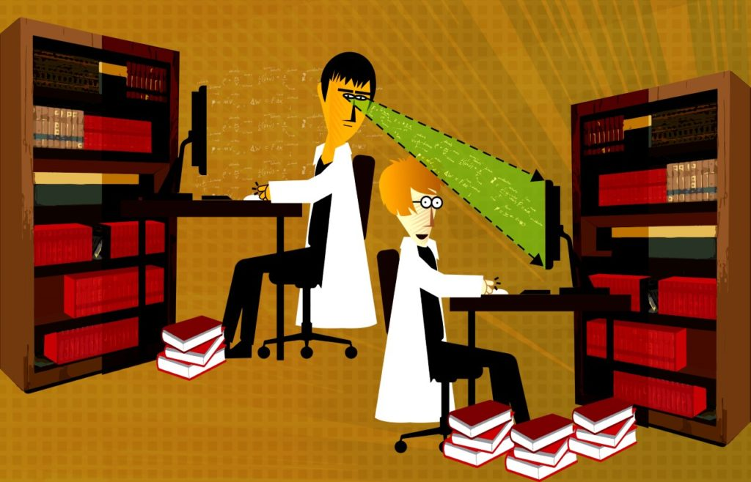
Plagiarism
Plagiarism is the fraudulent representation of another person's language, thoughts, ideas, or expressions as one's own original work.
Such representations are generally considered to violate academic Integrity and journalistic ethics as well as social norms of learning, teaching, research, fairness, respect and responsibility in many cultures. It is subject to sanctions such as penalties, suspension, expulsion from institute or work, substantial fines and even imprisonment.

Slide 5
ICT Act 2006
ICT Act 2006, undertaken by the Parliament received approval from the
President on 23 Ashwin, 1413 corresponding to 8 October 2006.
This act prepared to provide legal recognition and security of Information and
Communication Technology and rules of relevant subjects.

Slide 6
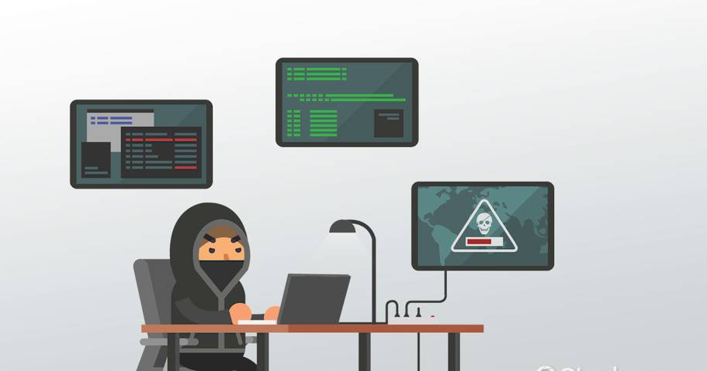
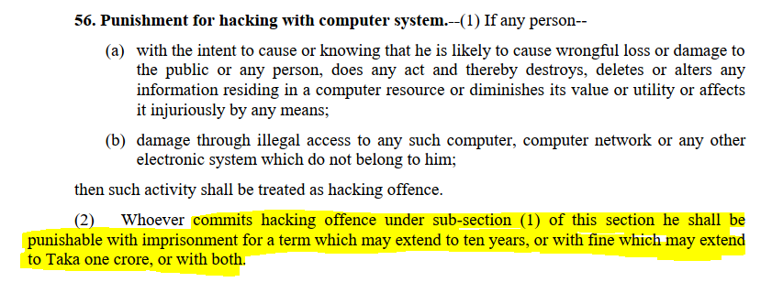
56. Punishment for hacking with computer system

Slide 7
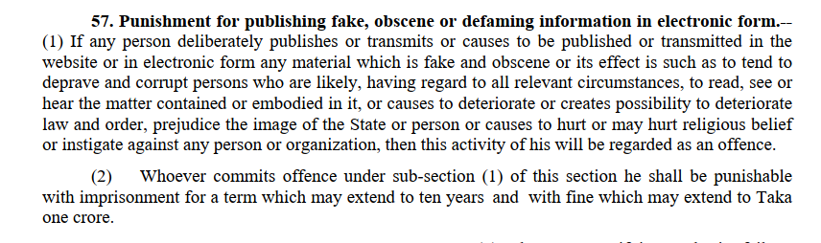
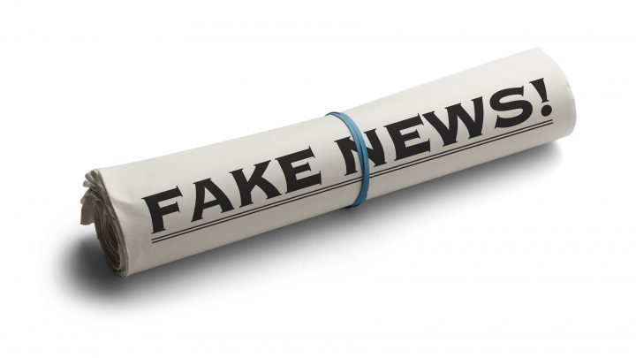
57. Punishment for publishing fake, obscene or defaming information in electronic form.

Slide 8
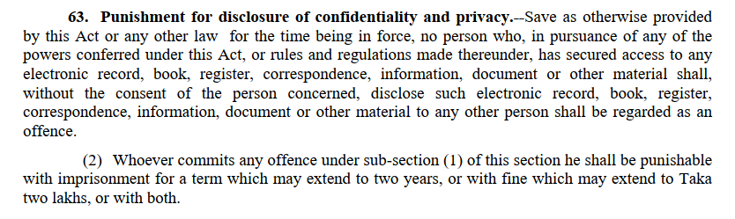
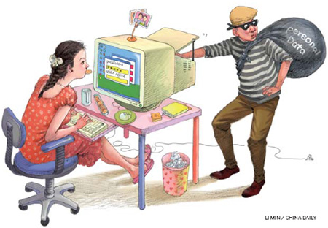
63. Punishment for disclosure of confidentiality and privacy

Slide 9
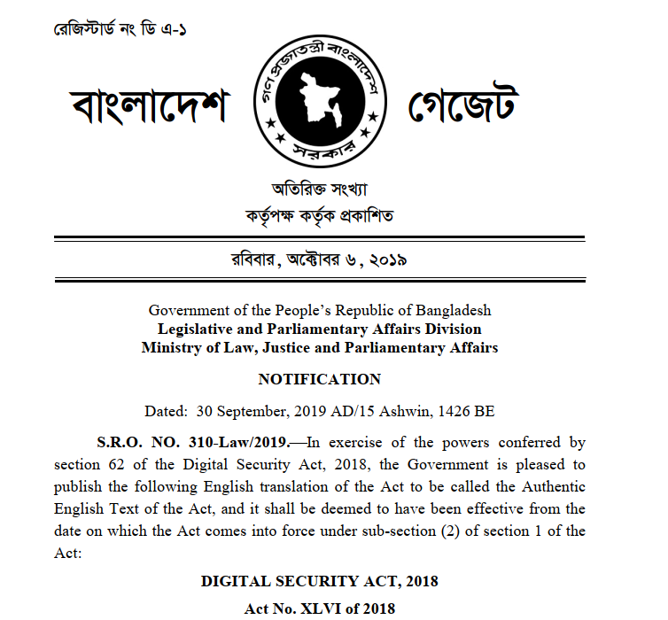
Digital Security ACT 2020
An Act to make provisions for ensuring digital security and identification,
prevention, suppression and trial of offences committed through digital
device and for matters ancillary thereto

Slide 10
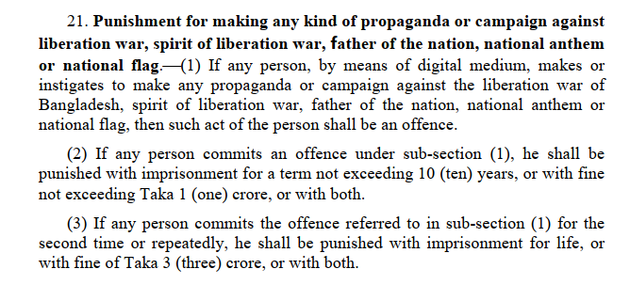
Punishment for making any kind of propaganda or campaign against liberation war, spirit of liberation war, father of the nation, national anthem or national flag

Slide 11
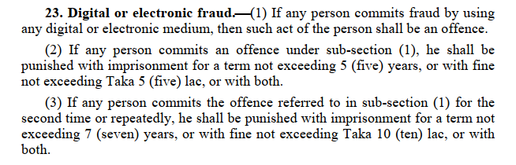
Digital or electronic fraud

Slide 12
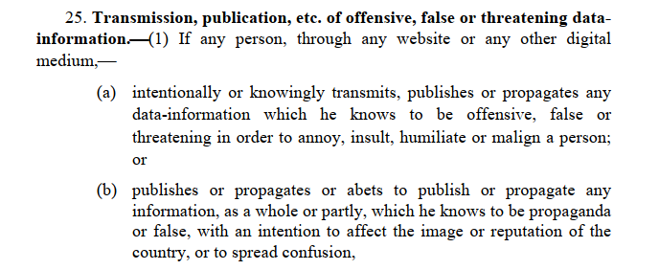
Transmission, publication, etc. of offensive, false or threatening data- information

Slide 13
Reference
[1] Link: https://www.cirt.gov.bd/wp-content/uploads/2020/02/Digital-Security-Act-2020.pdf

